Slide 1
ECE 143: National University Analysis
Chen-Lin Ko
Datzael Gomez
Eric Megrabov

Slide 2
Background
Research Question: what kind of students are at each university in the United States, what sort of performance does each state have on exams, debt levels corresponding to universities in each state, and how they have changed in the last five years
Data Visualization
Heat Maps used to determine ethnicities/sex by location with Google Maps for Python
Bar graphs display states with best results on the SAT and ACT
Data is from 2010-2011 and 2015-16 (most updated score range with the old SAT system out of 2400 points)

Slide 3
Dataset Description
College Scorecard Data
https://collegescorecard.ed.gov/data
Contains variety of data such as student completion, debt, earnings, major distributions, ethnicity distributions, and exam scores
Includes information from 1996 up to 2016
Has data from 7,594 universities

Slide 4
Dataset Issues
Far too much data to be used effectively
Needed to be filtered and cleaned significantly
Need to delete extraneous information
Fix unclear codenames
Deal with null data

Slide 5
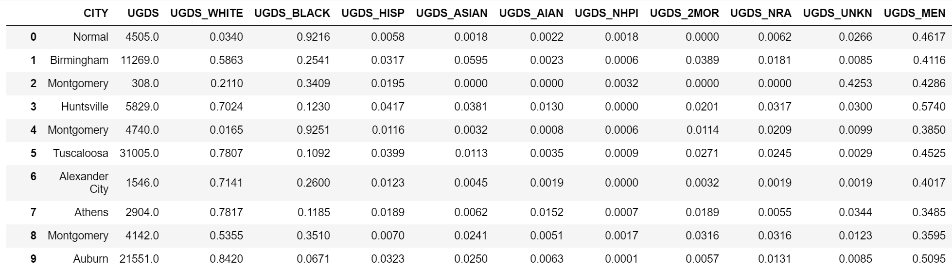
Dataset: Excess Data Fix
Started with 2059 attributes
Far too much and too specific data
Ex: Award of more than two but less than four academic years in Biological And Biomedical Sciences.
Manually added relevant columns to new set

Slide 6
Dataset: Null Data Fix
Decided to remove any schools that had relevant data that was null
After removal of:
null ethnicities, 6858 schools remained
null debt, 4611 schools remained
null SAT scores, 728 schools remained
null ACT scores, 324 schools remained
Helped not only clean the dataset, but also shortened it so that computation speeds were greatly improved

Slide 7
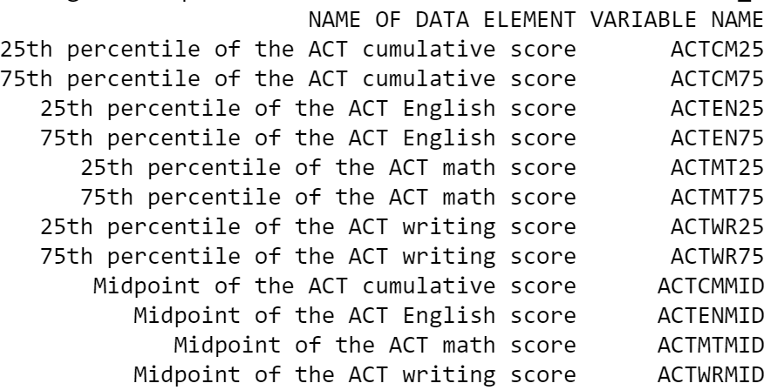
Dataset: Code Name Fix
Some code names were very unclear
New dictionary was developed so that dataset would be more readable
New name-to-code name translation can be seen below

Slide 8
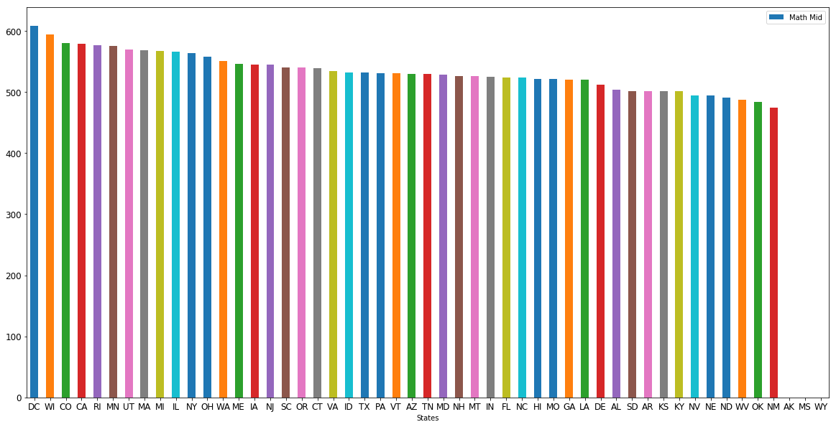
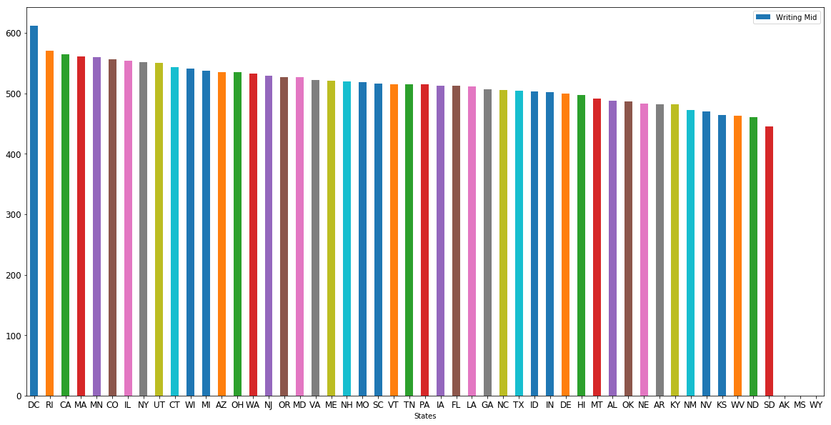
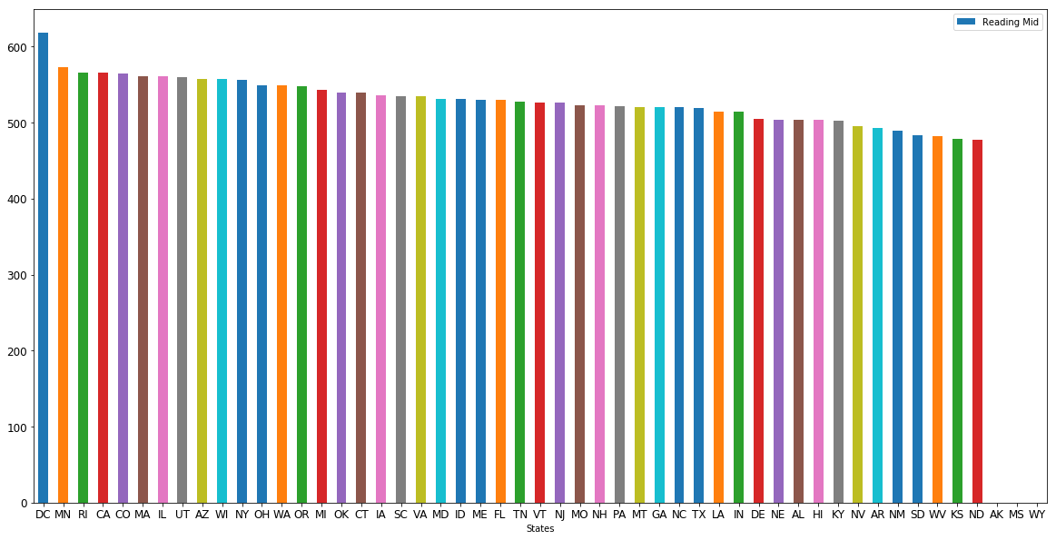
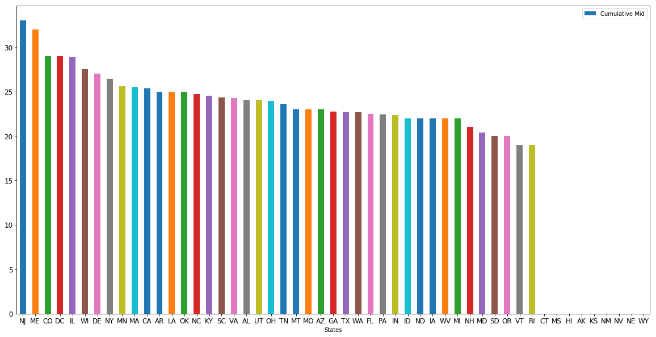
Results
States with top SAT/ACT scores 2010-2011
Notes:
Some of the top states are Washington DC, Wisconsin, Colorado, and Rhode Island
Some of the bottom states are usually North Dakota, South Dakota, Oklahoma, and Kansas

Slide 9
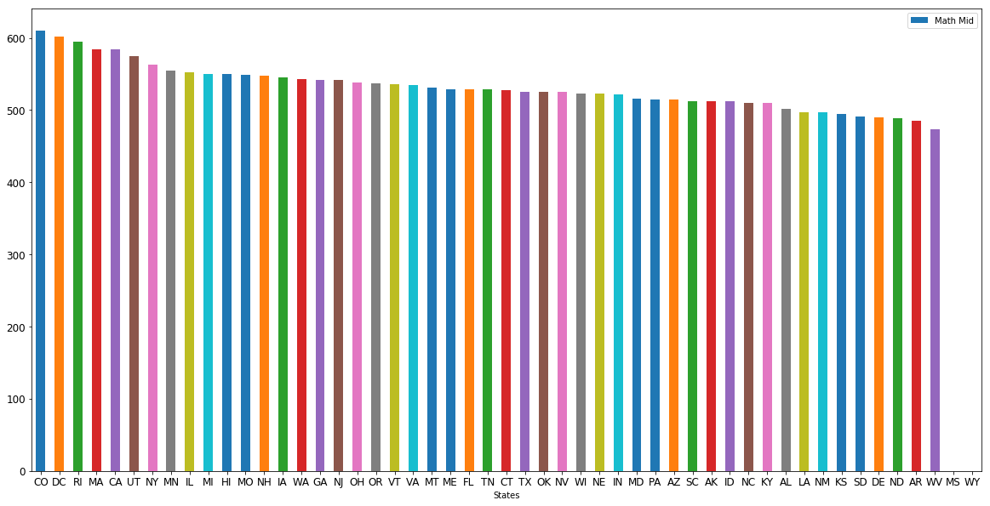
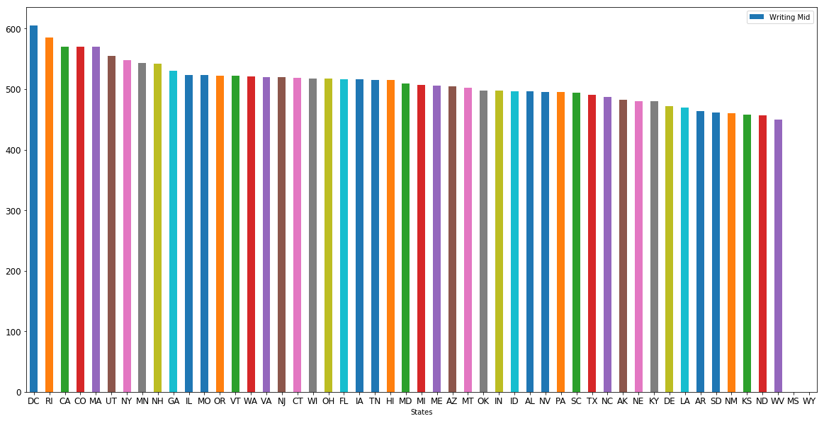
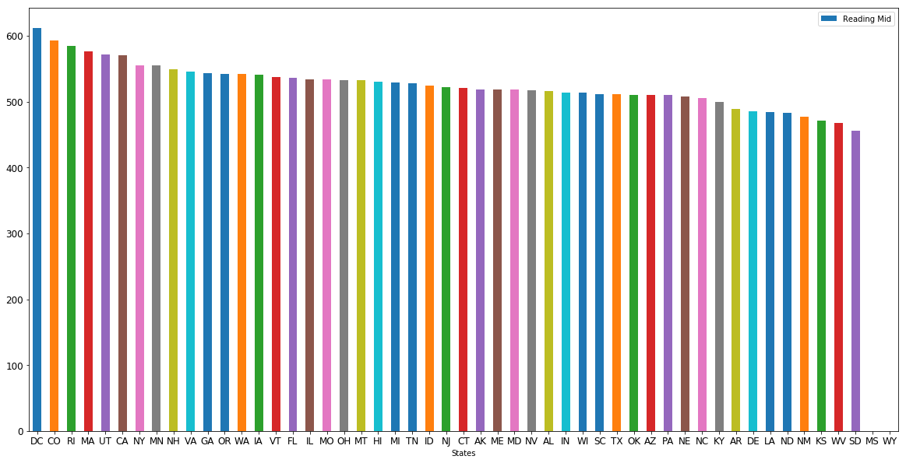
Results
States with top SAT/ACT scores 2015-2016
Notes:
1) DC gets a little worse over time but it’s still one of the top states

Slide 10
Test Score Analysis: Top
District of Columbia has overall best scores
Consistently in top 5 best scores for 2015-2016, best in all categories for 2010-2011
Best SAT scores in all categories were slightly over 600
Best ACT average was 33
Top 5 states: District of Columbia, Wisconsin, Colorado, Rhode Island, Minnesota

Slide 11
Test Score Analysis: Bottom
Bottom states: New Mexico, Oklahoma, West Virginia, North Dakota, South Dakota, Nebraska
Mostly Southern and Midwestern states
Worst SAT scores were close to or below 500 in all categories
Worst average score on ACT was 20
49th percentile
Not much change in score values from 2010-2015

Slide 12
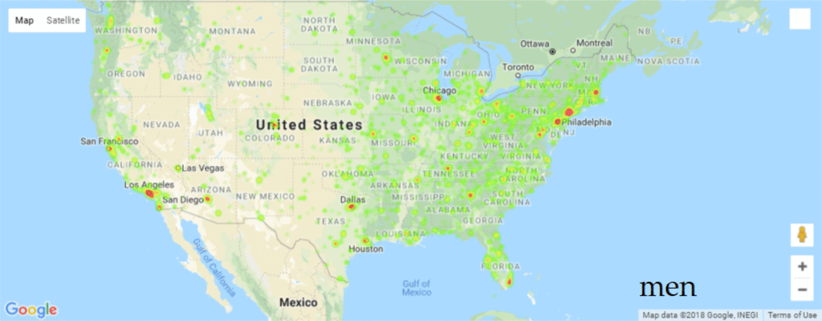

Student Body Heat Map
2010-2011
2015-2016
Notes:
Here are two gifs that show how heat maps of gender and ethnicity and how they change over time

Slide 13
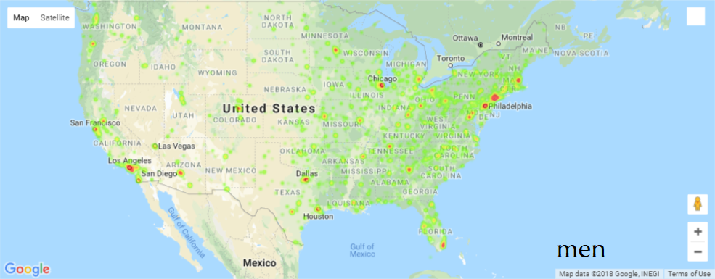
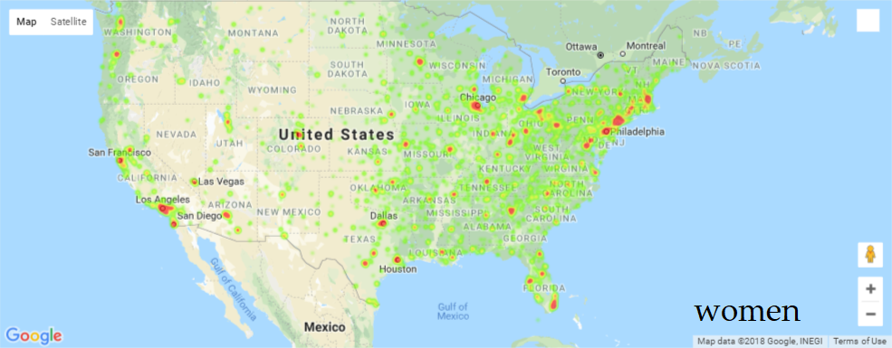
Gender Heat Map: 2010-2011
Notes:
It looks like there are more women attending universities than men since there are more points of higher intensity than there are of men
There are also significantly more women in east coast universities than men

Slide 14

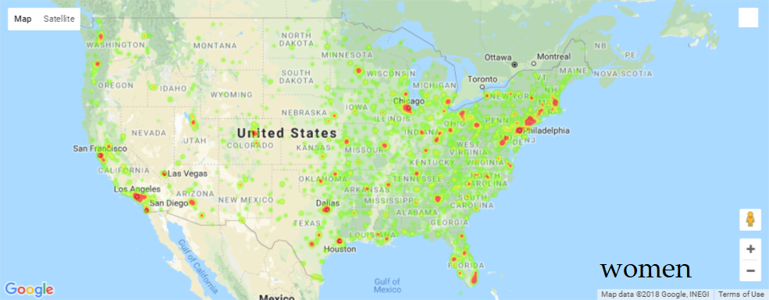
Gender Heat Map: 2015-2016
Notes:
In general, both male and female enrollment in universities increased slightly in the five year gap between 2010 and 2015
This indicates that male enrollment is not declining, but rather female enrollment is increasing

Slide 15
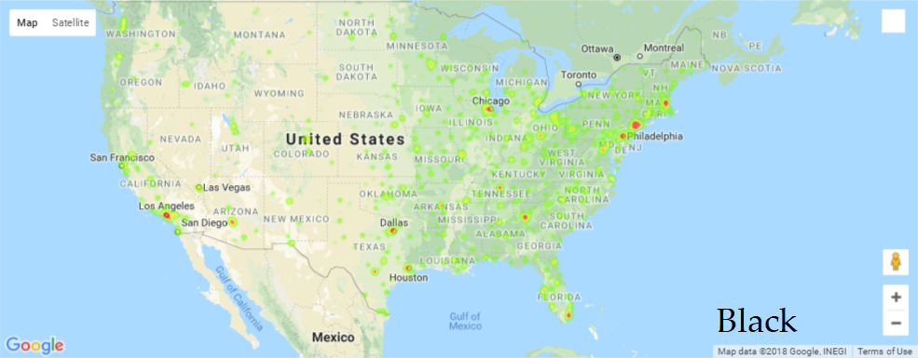

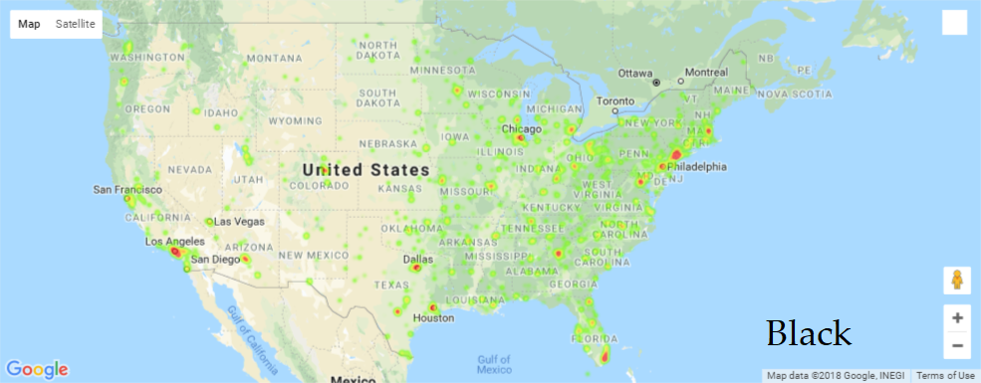
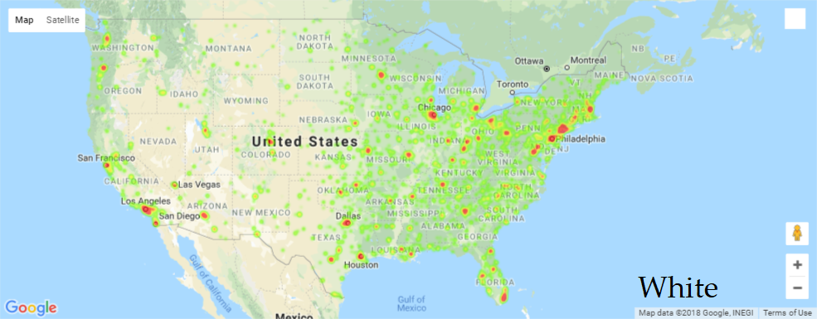
Ethnicity Heat Map: Black vs White
Notes:
1) The top row contains 2010-2011 enrollment data for black and white students while the bottom row contains 2015-2016 enrollment data
2) As expected, there are significantly more white students enrolled in university since the overall US population of white people is far greater than black people
3) Interestingly, it looks like white enrollment stays virtually the same going from 2010 to 2015. However, black enrollment has noticeable increases. Especially in Los Angeles, Florida, and some Texan cities, the intensity of the high-population areas is increased, indicating that more African-Americans are pursuing college degrees

Slide 16
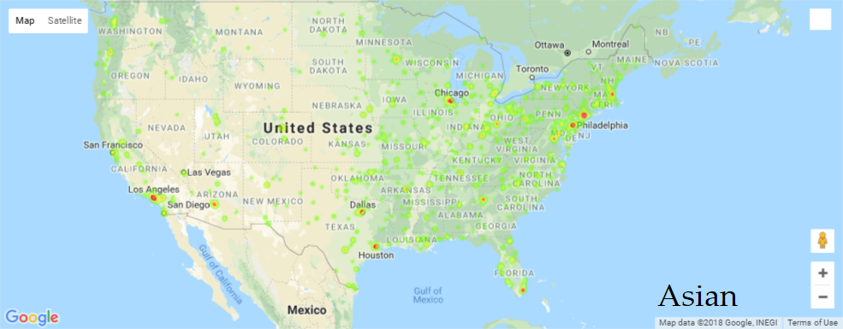
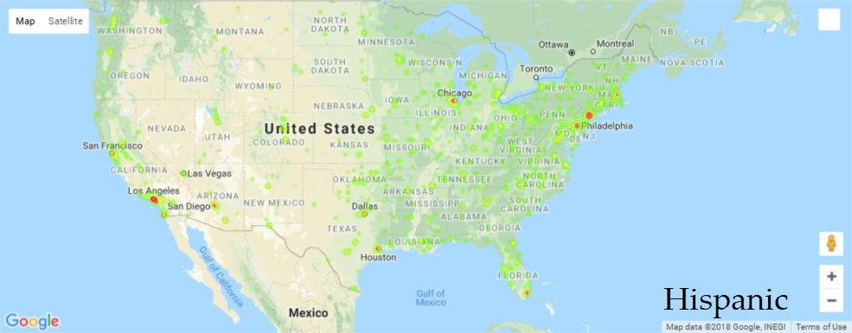


Ethnicity Heat Map: Asian vs Hispanic
Notes:
Again, the top row is 2010-2011 data, bottom row is 2015-2016 data.
Note that there are very few Asians and Mexicans in Midwestern and Southern states
There was not a lot of enrollment change in the five year gap for either ethnicity. There are some boosts in high population cities and a few new dots in the South, but not as significant as black enrollment change

Slide 17
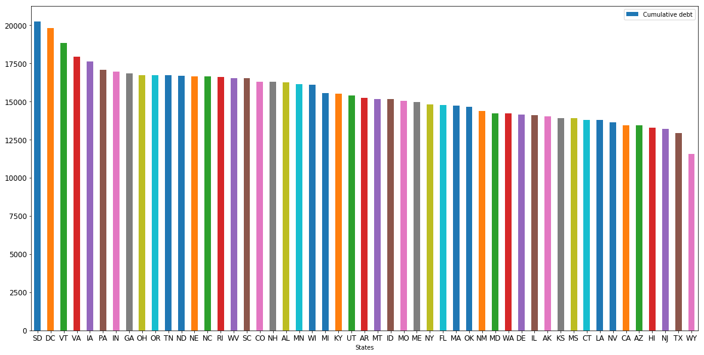
Student Debt: Cumulative 2010-2011
Notes:
Another statistic we looked at was student debt. In 2010, the highest cumulative debts were in South Dakota, DC, and Vermont. South Dakota had an average student debt of over $20,000. These states might appear due to a variety of reasons such as high tuition, low pay after college, or high cost of living.
On the other hand, Wyoming, Texas, and New Jersey had the lowest student debt of under $12,000.

Slide 18
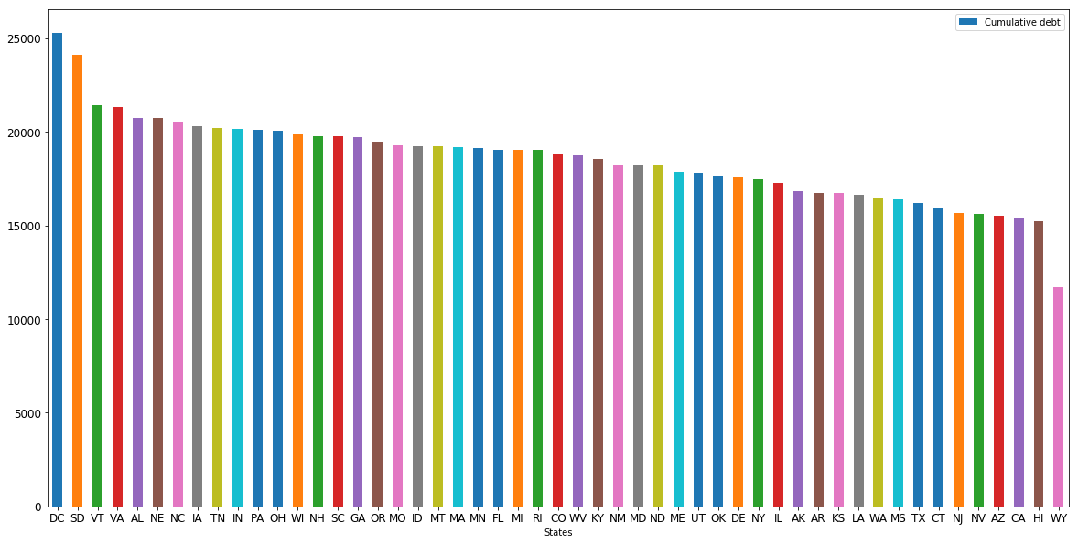
Student Debt: Cumulative 2015-2016
Notes:
Here you can see the debts in 2015. Student debt clearly rose from 2010 to 2015. Not counting Wyoming, every other state has an average cumulative debt increase of around $4,000 to $5,000. Wyoming seems to be the only outlier. Notice that DC, South Dakota, and Vermont are all still in the top 3 for highest debt.

Slide 19
Summary
DC correlates with high test scores but also higher debt after college
The South and Midwest typically show poorer exam scores while the East and West show higher ones
Male enrollment is increasing more slowly than female enrollment
African-Americans are enrolling at a faster rate than white, Asian, or Hispanic students

Slide 20
Thank You

